Slide 1

Decoding Student Life
A Data-Driven Story of Student Well-being and Success
Handcrafted by Gor Hoveyan

Slide 2

Introduction
Ghost in the machine: Before a student even opens a book, are there invisible forces at play? We’ll explore the "ghosts" in the data like family background and etc., that shape a student's starting line.
Myth of the Lone Genius: Does academic success happen in a vacuum? We'll investigate whether the "lone genius" who just studies all day is a myth, and see how crucial a balanced, healthy lifestyle really is.

Slide 3

The Main Questions
Choose Your Character: If student life were a video game, what are the four playable characters, or "archetypes," that emerge from our data? And more importantly, which character build is most likely to win the game of grades?
The Secret Recipe: Is there a hidden "recipe for success" in our data? We’ll shift through the habits of top performers to see if we can uncover the secret ingredients.

Slide 4




Dataset at a Glance
Demographics
Age
Gender
Parental education
Wellness Habits
Sleep Hours
Diet Quality
Exercise Frequency
Academic Factors
Study Hours
Class Attendance
Exam Score
Digital Habits
Social Media Hours
Netflix Hours
Internet Quality

Slide 5

Ghost in the Machine
Before a student even opens a book, are there invisible forces at play?

Slide 6
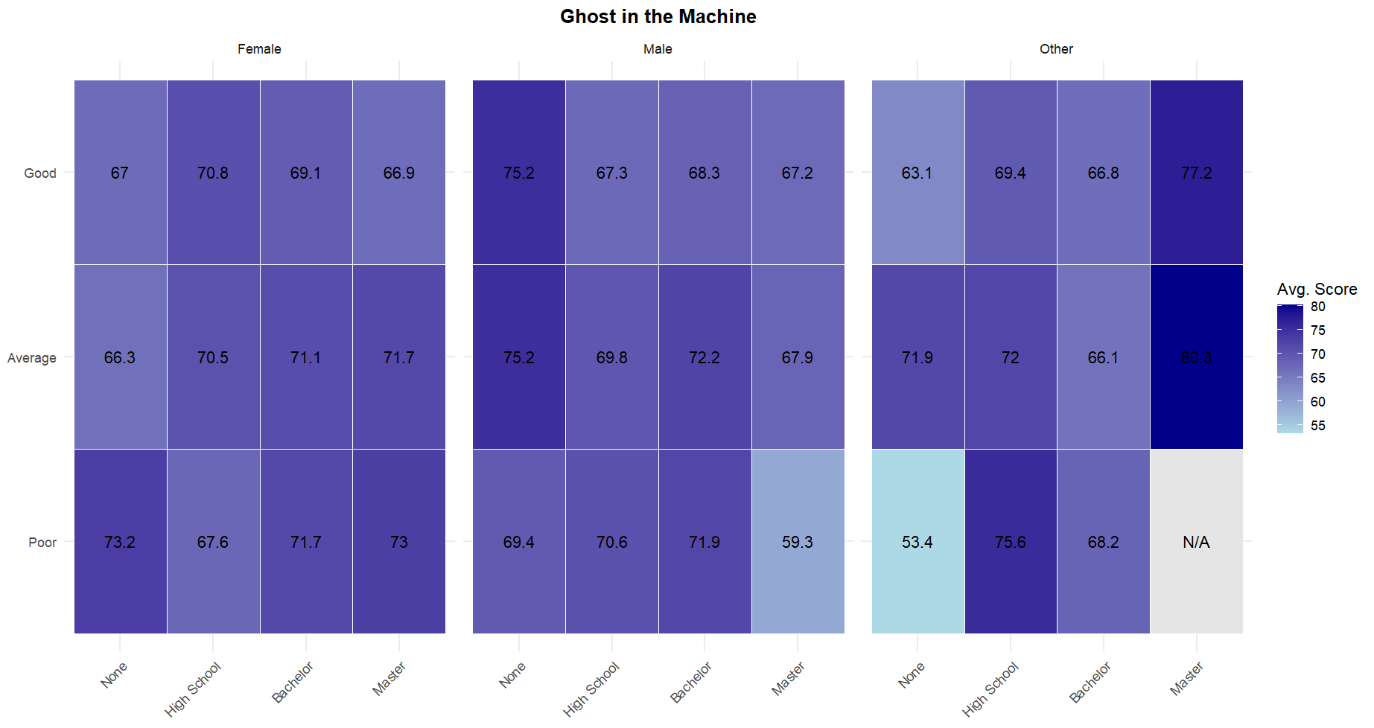

Slide 7

The "Sleep vs. Study" Dilemma
Is academic success just about studying, or is there more to it? Let's look at the 'Myth of the Lone Genius

Slide 8
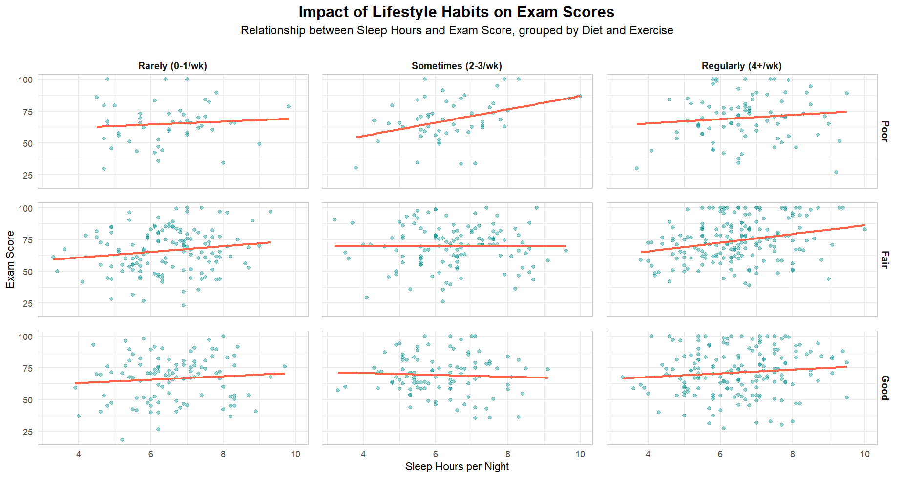

Slide 9

The Juggling Act
When students take on a part-time job, what part of their academic life pays the price first: their class attendance or their study time?

Slide 10
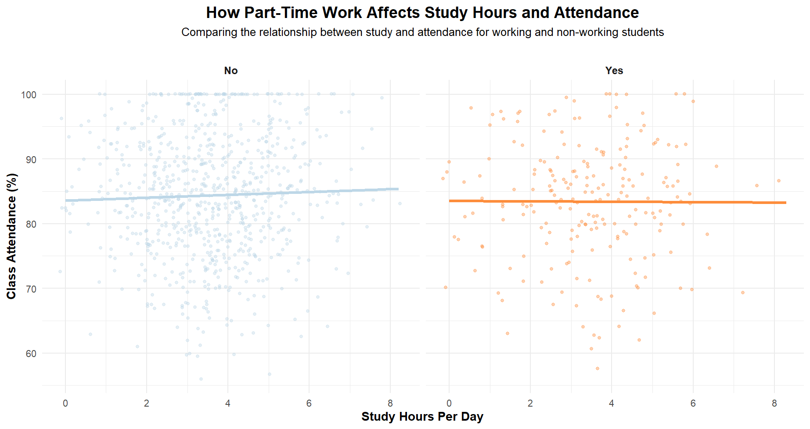

Slide 11

The Digital Kryptonite
But what about the modern student's biggest challenge? What is our 'Digital Kryptonite'?

Slide 12
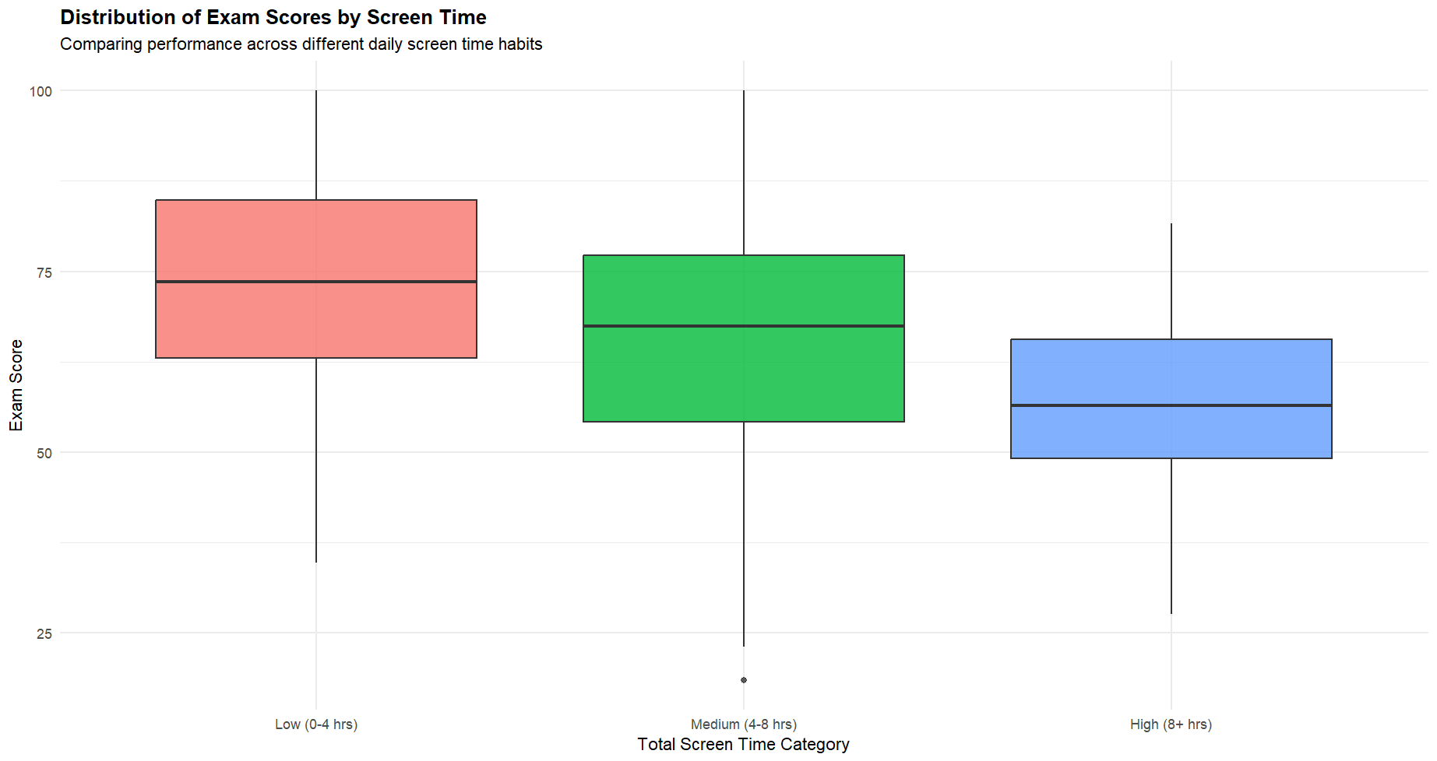

Slide 13
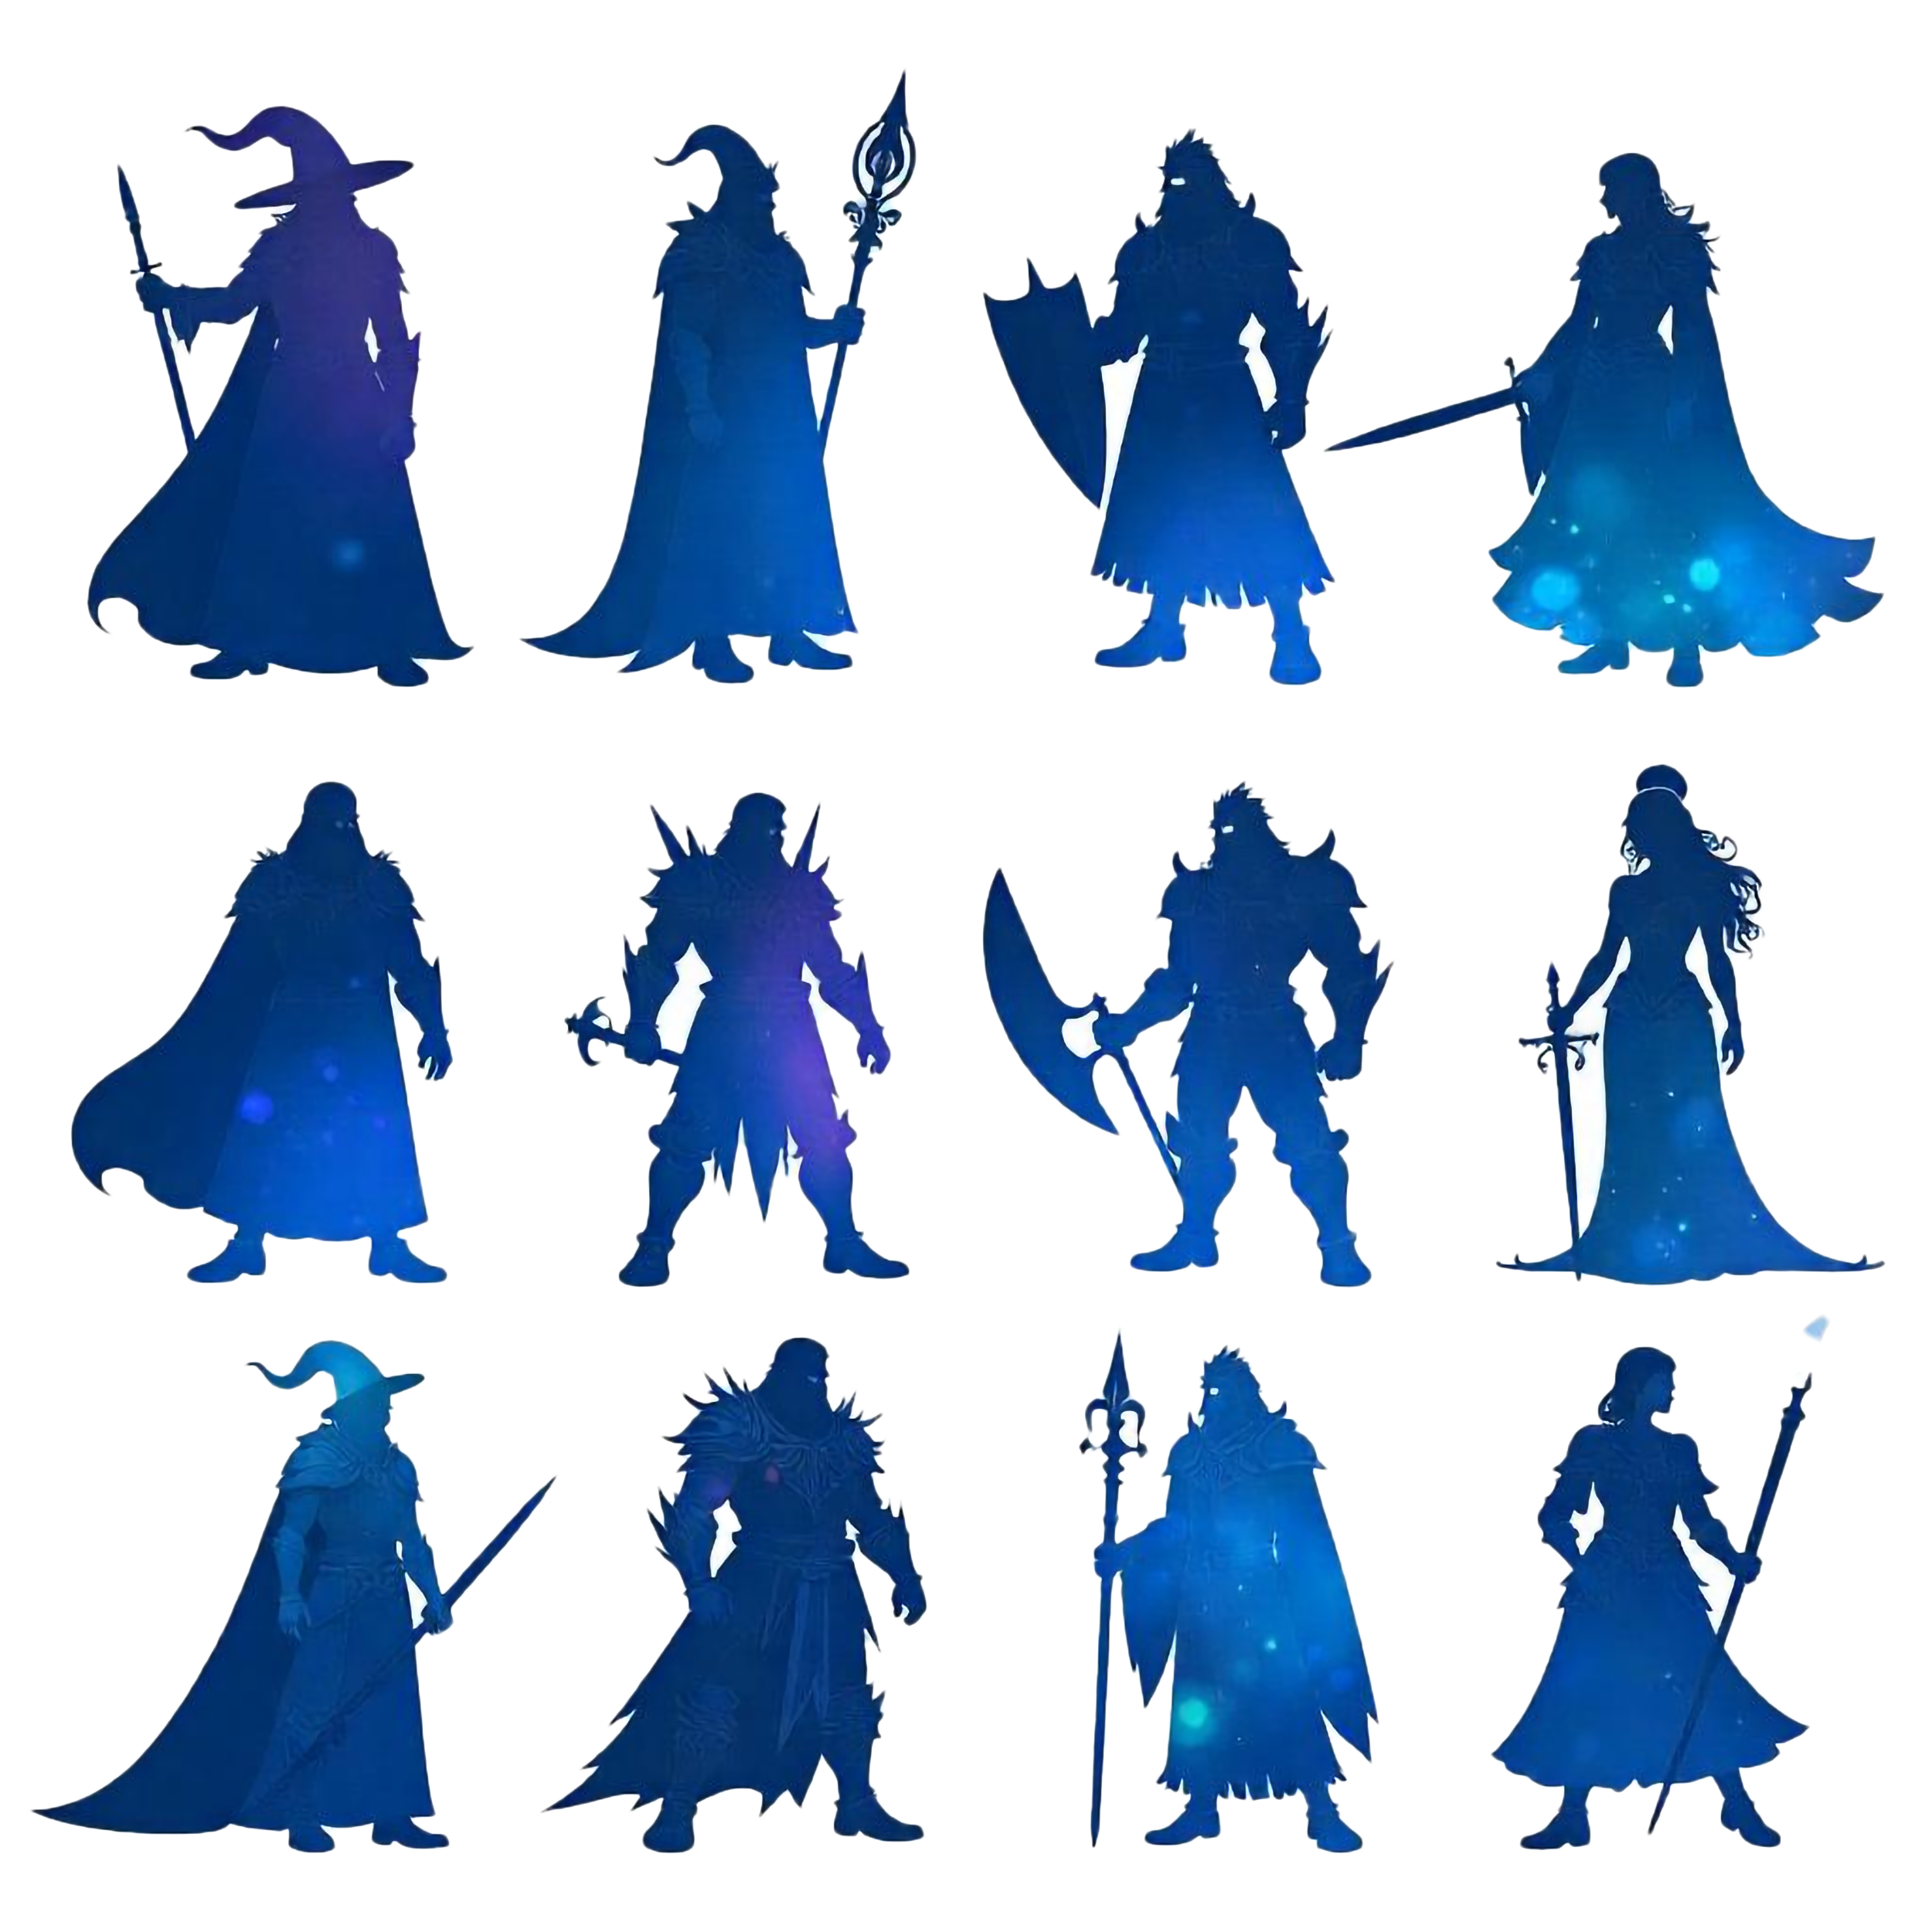
Choose Your Character
So, we have wellness, studying, and screen time all competing. What happens when we put them all together? If student life were a video game, what are the four playable 'characters' or 'archetypes' that emerge?

Slide 14
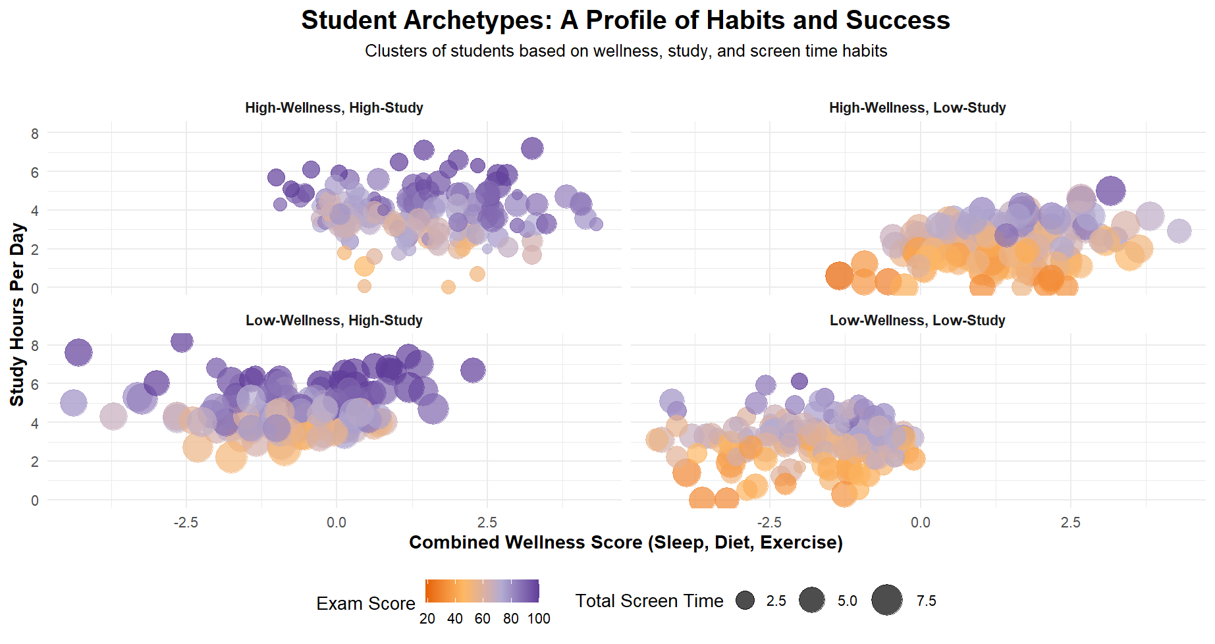

Slide 15



Secret Recipe
So, what is the secret recipe for success?

Slide 16
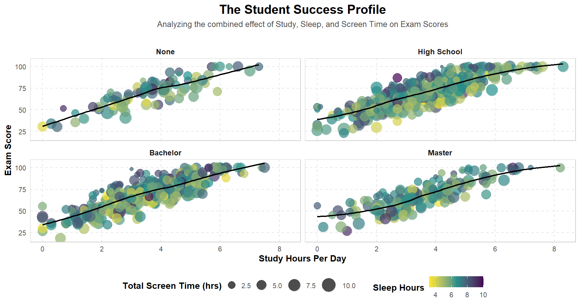

Slide 17



The Conclusion
Screen Time is the Enemy
Wellness is Non-Negotiable
Foundation Matters
Balance is the Ultimate Key

Slide 18

Thank You For Your Attention
Handcrafted by Gor Hoveyan

